Slide 1
Review of Set Theory

Slide 2




Review of Set Theory
A set is an unordered collection of things (elements).
•
•
•
•

Slide 3


Review of Set Theory
The set of natural numbers,
The set of integers,
The set of real number

Slide 4






Review of Set Theory
Set is a subset of set if every element of is also an element of We write where " " indicates "subset ".
Example:
•
•
Notes:
A is a subset of B

Slide 5









Review of Set Theory
if and only if and
Example:
Universal set:
The set of all things that we could possibly consider in a given context.
Universal set
Null set ; For any set
Notes:
Null or empty set

Slide 6

Venn Diagrams
In a Venn diagram any set is depicted by a closed surface.
6
Notes:
Let “Omega” be the set containing all sets that do not contain themselves.

Slide 7





Union: The union of two sets all objects in or | and | is denoted by and consist of
if and only if |  | or
Set Operations
Notes:
The union of two sets A and B is the set containing all the elements in A as well as all the elements in B.
Properties of the Union
A ∪ Ø = A
A ∪ A = A
If A ⊂ B, then A ∪ B = B
A ∪ B = B ∪ A
A ∪ (B ∪ C) = (A ∪ B) ∪ C

Slide 8

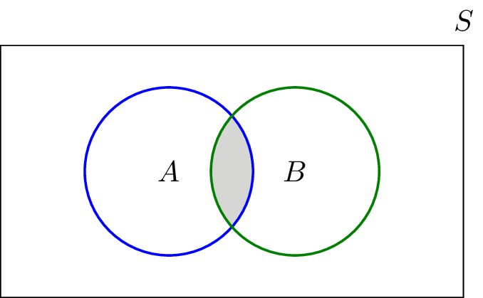
Set Operations
Intersection:
The intersection of two sets
objects in both and
and is denoted by
and consist of all
Notes:
The intersection of sets A and B is the set containing elements that are in both A and B.
Properties of the Union
A ∩ Ø = Ø
A ∩ A = A
If A ⊂ B, then A ∩ B = A
A ∩ B = B ∩ A
A ∩ (B ∩ C) = (A ∩ B) ∩ C
Let A = {0, 1} and B = {1, 2, 3}
What is A union B? {0, 1, 2, 3}
What is A intersect B? {1}
Let A be all the odd natural numbers
Let B be all the even natural numbers
What is A union B? All natural numbers
What is A intersect B? The empty set

Slide 9




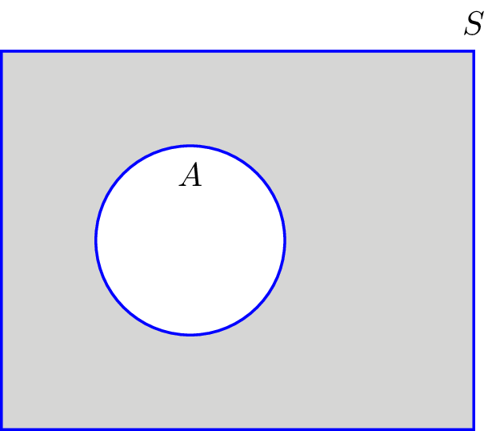


Set Operations
Complement:
The complement of a set
that are not in
denoted by
is the set of all elements in
Notes:
The set-theoretic difference of two sets A and B is the set of all elements in A that are not in B.
If A ⊂ B, the set-theoretic difference of A and B is called the complement of B with respect to A.
A complementary relation is the set complement of A.
Let A and B be subsets of the universal set S.
Properties:
Ø^{c} = S
S^{c} = Ø
(A^{c}) ^{c} = A
If If A ⊂ B, then B^{c} ⊂ A^{c}

Slide 10

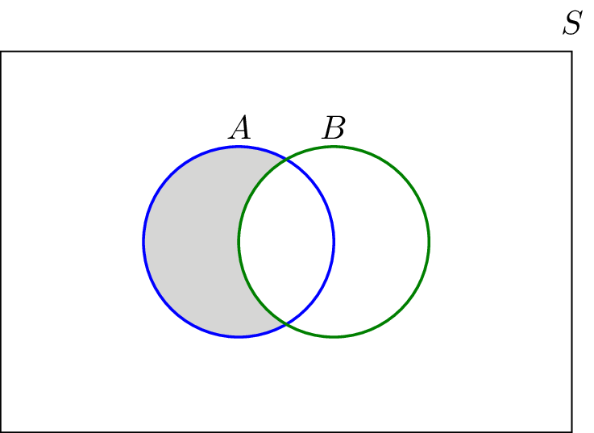

Set Operations
Difference (subtraction):
The subtraction of set from in
is all elements in
that are not

Slide 11






Set Operations
Mutually exclusive set (disjoint):
Two sets and are mutually exclusive (or disjoint) if
are m.e. if

Slide 12



Set Operations
Partition:
A collection of sets
a) They are disjoint . b)
is a Partition of if

Slide 13
Set Operations
Theorem : De Morgan's law
(A ∪ B)^{c} = A^{c} ∩ B^{c}
(A ∩ B)^{c} = A^{c} ∪ B^{c}
Notes:
If A and B are subsets of the universal set S
(A ∪ B)^{c} = A^{c} ∩ B^{c}
(A ∩ B)^{c} = A^{c} ∪ B^{c}
Example.
Let S be the set of all animals.
Let A be the set of dogs.
Let B be the set of cats.
(Dogs ∪ Cats)^{c} = Dogs^{c} ∪ Cats^{c}
“Animals that are neither dogs nor cats are not dogs and are not cats”

Slide 14





Set Operations
Example: Let | and
a) b) |  | c)
d) f) |  | g)
The sets |  | form a partition of
Notes:
A ∪ B = {1, 2, 4, 6}
A ∩ B = {2}
A^{c} = {3, 4, 5, 6}
B^{c} = {1, 3, 5}
(A ∪ B)^{c} = {3, 5}
(A ∩ B)^{c} = {1, 3, 4, 5, 6}

Slide 15
Set Operations
Theorem : Distributive law
•
•
Notes:
Example.
“I only wear white or blue shirts.”
Shirts ∩ (Blue clothes ∪ White clothes)
= Shirt and (Blue or White)
= (Blue shirts) or (White shirts)
“I only wear blue shirts or white shirts”

Slide 16
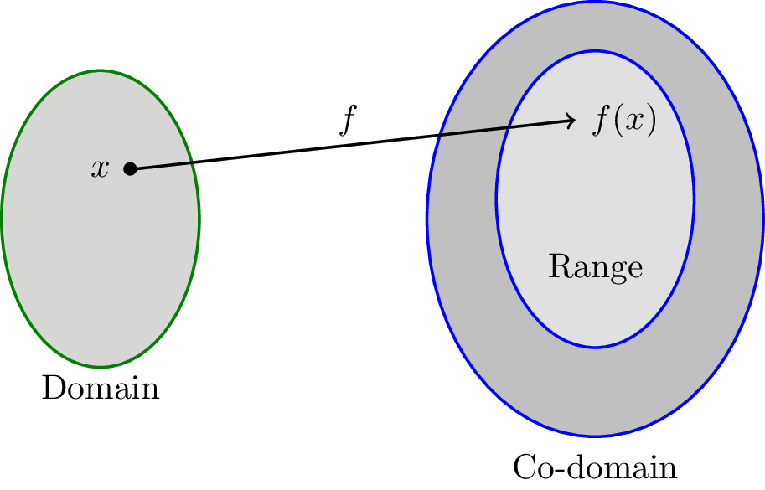






Functions
Domain Co-domain
Range: the set of all the possible values of
(Range
)
Notes:
f is a function if f maps each element of X to an element in Y.
Range is a subset of Y.

Slide 17



Functions
Example:
Consider the function
defined as
one-to-one (invertible):
Notes:
Set builder notation:
Example.
The set of prime numbers:
P = {p | p is prime}
“p such that p is a prime”
Predicate: p is prime
“such that”: vertical bar
Codomain of f is R⁺

Slide 18


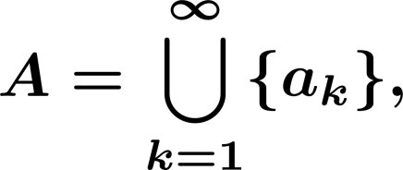


Countable and Uncountable Sets
Cardinality of a set is the number of elements in
set is finite if
set if countable if it is finite Or the elements of
listed in a sequence that is,
can be enumerated or
Ex:
is countable.

Slide 19

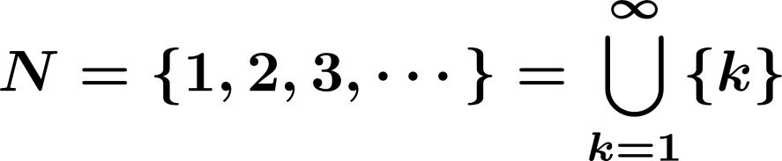
Countable and Uncountable Sets
Uncountable: Not countable.
e.g.,
Equivalently: set is countably infinite if it is in one-to-one correspondence
with

Slide 20


Countable and Uncountable Sets
Example:
(set of integers) is countable (countably infinite).
Because

Slide 21
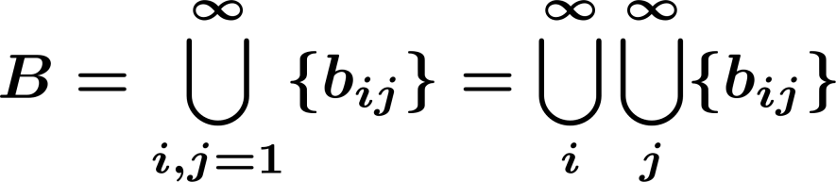
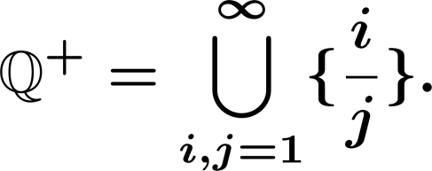
Countable and Uncountable Sets
Example:
Show that a set of the form
is countable.
Example:
Show that the positive rational number form a countable set:

Slide 22



Countable and Uncountable Sets
But is not countable.
In fact, any interval where is not countable.

Slide 23
Random experiment
Random experiment:
A phenomenon whose outcome cannot be predicted with certainty, such as
Random experiment:
Roll a die
Roll a die three times
Flip a coin

Slide 24
Random experiment
Outcome:
An outcome is the result of a random experiment.
Roll a die 3
Roll a die 3 times (2, 3, 6)

Slide 25



Random experiment
Events:
An event is collection of possible outcomes.
Roll a die (Event=E)

Slide 26

Random experiment
Sample Space:
The sample space is the set of all possible outcomes.
Roll a die:
random experiment
Roll a die three times
an outcome

Slide 27
Random experiment
Event
Sample space
Outcome
Set
Universal Set Element
We say that an event
element of
occurs if the outcome of the experiment is an

Slide 28








Random experiment
Partition:
A partition is a collectively exhaustive, and mutually exclusive
set of events, i.e.,
is a Partition if

